Slide 1
Lecture 20: data modeling Ch 7
Punjab University College of Information Technology

Slide 2
Data Modeling and
Entity Relationship (E-R)
Diagramming

Slide 3
Why Data Modeling?
examines data objects independently of processing
focuses attention on the data domain
creates a model at the customer’s level of abstraction
indicates how data objects relate to one another

Slide 4
What is a Data Object?
—something that is described by a set
Object
of attributes (data items) and that will be
manipulated within the software (system)
each
instance
of an object (e.g., a book)
can be identified uniquely (e.g., ISBN #)
each plays a necessary role in the system
i.e., the system could not function without
access to instances of the object
each is described by attributes that are
themselves data items

Slide 5
Typical Objects
external entities (printer, user, sensor)
things
(e.g, reports, displays, signals)
occurrences or events (e.g., interrupt, alarm)
roles
(e.g., manager, engineer, salesperson)
organizational units
(e.g., division, team)
places
(e.g., manufacturing floor)
structures (e.g., employee record)

Slide 6
Data Objects and Attributes
A data object contains a set of attributes that act as an aspect, quality, characteristic, or descriptor of the object
object: automobile
attributes:
make
model
body type
price
options code

Slide 7
What is a Relationship?
relationship
—indicates “connectedness”;
a "fact" that must be "remembered"
by the system and cannot or is not computed
or derived mechanically
several instances of a relationship can exist
objects can be related in many different ways

Slide 8
ERD Notation
One common form:
(0, m)
object
relationship
object
1
(1, 1)
2
attribute
Another common form:
object
relationship
object
1
2
(0, m)
(1, 1)

Slide 9
Building an ERD
Level 1—model all data objects (entities) and their “connections” to one another
Level 2—model all entities and relationships
Level 3—model all entities, relationships, and the attributes that provide further depth

Slide 10
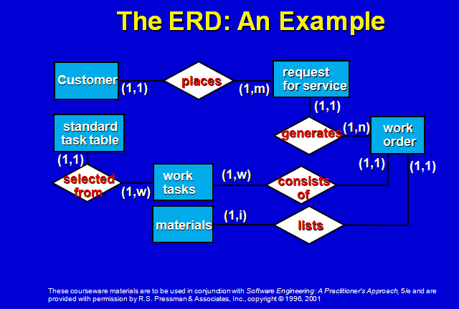

Slide 11
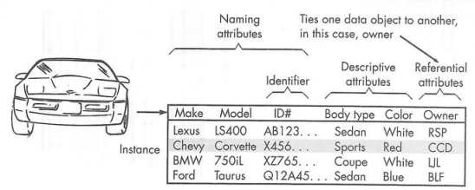
Data Objects and Attributes

Slide 12
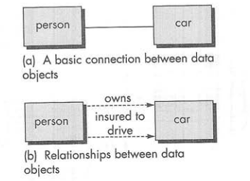

What is a Relationship?

Slide 13
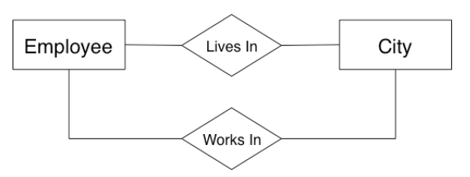
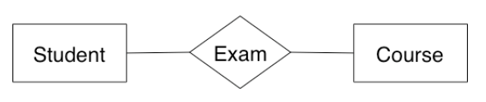
What is a Relationship?

Slide 14
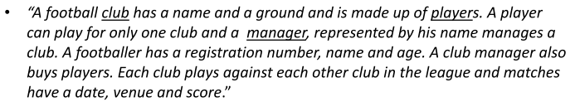
Example

Slide 15
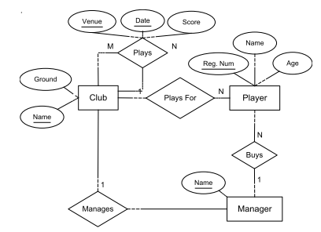
Example

Slide 16
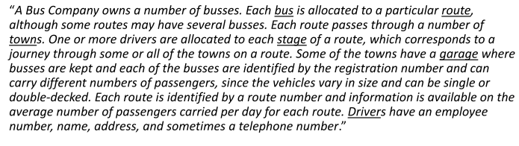
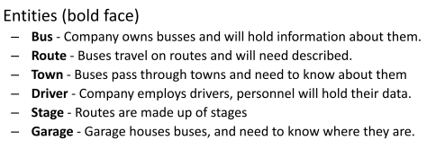
Example 2

Slide 17
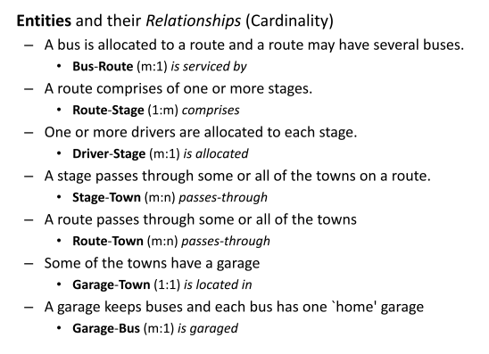
Example 2

Slide 18

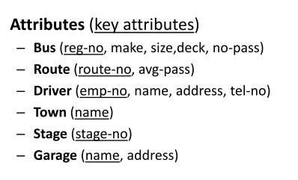

Slide 19
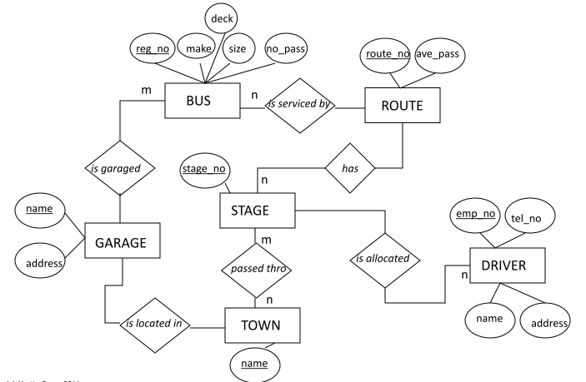

Slide 20
Example Case Study
PC Associates is a large, multinational consulting corporation, which uses a number of PCs and software packages in the course of her work. PC Associates needs to maintain the following information about the PCs and software packages its employee uses to do their jobs. For each PC, the computer number, the computer model and manufacturer, and the type of microprocessor needed to be stored. Data for each employee also needed to be stored - such as the employee name, employee number, and phone number. Also for each PC, the inventory tag number, location, computer number and the number of the employee who owns the PC. For each software package, the package number, current cost, type, name and version needed to be stored. Also for each software package installed on a PC, the package number and cost, installation date and inventory tag number needed to be stored.

Slide 21
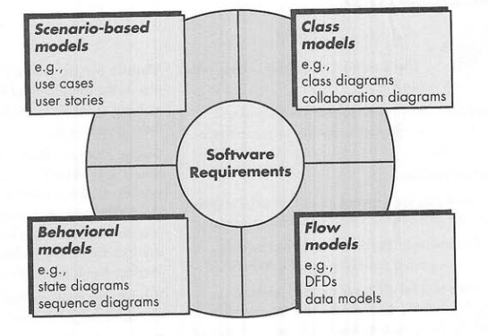
Requirement analysis
  Flow-oriented models that represent the functional elements of the system and how they transform data as it moves through the system

Slide 22
The Flow Model
Every computer-based system is an information transform ....
computer
based
system
input
output

Slide 23
Flow modeling notations
external entity
process
data flow
data store

Slide 24
External Entity
A producer or consumer of data
Examples: a person, a device, a sensor
Another example: computer-based System
Data must always originate somewhere and must always be sent to something

Slide 25
Process
A data transformer (changes input
to output)
Examples: compute taxes, determine area, format report, display graph
Data must always be processed in some way to achieve system function

Slide 26
Data Flow
Data flows through a system, begins
as input and is transformed into output.
base
compute
triangle
area
area
height

Slide 27
Data Store
Data is often stored for later use.
sensor #
sensor #, type,
location, age
look-up
sensor
data
report required
type,
location, age
sensor number
sensor data

Slide 28
Data flow diagram guidelines
all icons must be labeled with meaningful names
the DFD evolves through a number of levels of detail
always begin with a context level diagram (also called level 0)
always show external entities at level 0
always label data flow arrows
do not represent procedural logic

Slide 29
Constructing a DFD—I
determine external entities (producers and consumers of data)
create a level 0 DFD

Slide 30
Level 0 DFD Example
processing
request
user
requested
video
signal
digital
video
processor
monitor
video
source
NTSC
video signal

Slide 31
Constructing a DFD—II
write a narrative describing the transform
parse to determine next level transforms
develop a level 1 DFD
use a 1:5 (approx.) expansion ratio

Slide 32
The Data Flow Hierarchy
a
b
x
P
y
level 0
level 1
a
c
p2
f
p1
p4
b
d
5
p3
e
g

Slide 33
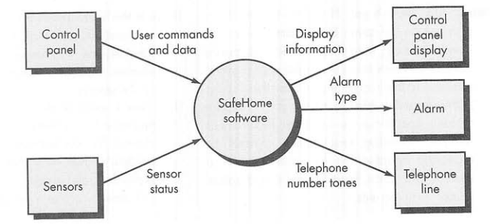

Slide 34
